Slide 1
Screenless Displays: The Future of Visual Interaction
1RV23MC080
Rajesha C U
Under the Guidance
Of
Dr. Deepika K
Associate Professor
Department of MCA

Slide 2
Agenda
Introduction
Technological Developments
Key Competitors
Sustainability and Societal Concern
Proposed Work
Conclusion
References

Slide 3

Introduction
Screenless Display refers to display technologies that enable visual information transfer without the need for traditional physical screens. These technologies present images or data directly to the human eye, onto surfaces, or even project visuals into open space.
Key Applications of the Domain
Healthcare – real-time data during surgery.
Education – 3D interactive learning.
Defense – AR-assisted mission data.
Entertainment & Wearable – smart lenses, gaming.
As digital interfaces become more immersive and less dependent on hardware, screenless display technologies are set to redefine how we interact with information. This topic is chosen to explore the future of human-computer interaction, its real-world applications, and how it challenges conventional display systems.

Slide 4
Technical Relevance
Screenless display is a cutting-edge technology that allows users to visualize and interact with digital content without using a traditional physical screen. Instead, it relies on alternative methods like light projection, retinal imaging, and holography to present visual data directly to the human eye or into the surrounding environment (e.g., air, glasses, or retina).
Types of Screenless Display Technologies:
Visual Image Display
Projects visible images onto physical surfaces or into the air (e.g., holograms).
Retinal Display
Directly projects images onto the retina using low-power laser or LED.
Uses brain-machine interface or holography to simulate a visual experience without an actual display.

Slide 5
Tools and Technologies Related to Screenless Display:
Digital Light Processing (DLP)
Laser Beam Scanning (LBS)
Holographic Projection
Augmented Reality (AR) Headsets
Retinal Projection Systems
Eye-Tracking Technology
Brain-Computer Interface (BCI)
Tool Most Suitable for Our Objective:
Retinal Projection Systems
This tool aligns best with the objective of delivering a screen-free yet immersive visual experience. Retinal displays project light directly onto the retina using low-power laser beams, creating a clear, high-resolution image perceived by the user without requiring a physical screen. This is ideal for wearable devices, smart glasses, and medical applications where compact and private display is essential.

Slide 6
Sustainability
Reduction in Electronic Waste (E-Waste):
Eliminates the need for physical screens, reducing production and disposal of LCD, LED, or OLED panels.
Encourages minimal hardware designs, particularly in AR glasses or retinal devices.
Energy Efficiency:
Screenless systems, especially retinal projection and holographic displays, consume less power compared to traditional displays.
Reduces battery load in wearable and portable devices, extending their lifespan.
Eco-Friendly Materials:
Reduced need for large-scale manufacturing of plastic, glass, and toxic materials used in traditional screens.

Slide 7
How It Supports Our Objectives Sustainably
The primary objective of screenless display is to enhance user interaction while reducing reliance on conventional screens.
By using retinal projection systems, our approach ensures:
Minimal use of physical resources.
Lower maintenance and replacement needs.
Extended usability in remote or harsh environments (ideal for military, trekking, or medical scenarios).
This leads to a long-term reduction in environmental impact and supports the development of green, future-proof technologies.

Slide 8
Social Concern
Unresolved Societal Problems
Limited Access to Visual Information for the Visually Impaired:
People with low vision or blindness face barriers in accessing digital content.
Traditional displays are not inclusive or adaptive.
Display Limitations in Harsh Environments:
Traditional screens are not reliable in extreme conditions ( bright sunlight, wet environments).
Environmental Pollution from E-Waste:
Millions of screens are discarded annually, contributing to toxic e-waste.
Recycling processes are complex and energy-intensive.

Slide 9
Domains That Can Benefit from Screenless Display
Healthcare & Medical Imaging:
Enables hands-free, real-time visualization during surgery or diagnostics.
Can assist visually impaired users through audio-visual augmentation.
Defense and Aerospace:
Retinal displays and HUDs provide situational awareness without bulky equipment.
Useful in combat zones, cockpits, and night vision applications.
Education & Training:
Enhances interactive learning with holographic projections and AR tools.
Automotive Industry:
Heads-Up Displays (HUDs) project essential driving information on windshields, improving safety.
Public Communication & Advertising:
Holographic displays reduce physical space and material usage for dynamic content in public spaces.

Slide 10
Proposed Solution
Key Technologies Used:
Retinal Projection / Smart Glasses (output interface)
Wireless Communication Module (for data transfer)
Microcontroller/Processor (to manage and format data)
Sensors / Cloud / Mobile (data sources)
How This Solves the Problem:
No physical display needed → reduces e-waste.
Low power wearable solution → enhances portability.
Hands-free visual experience → ideal for fieldwork, healthcare, and accessibility.
Real-time data delivery → ensures efficiency and usability.

Slide 11
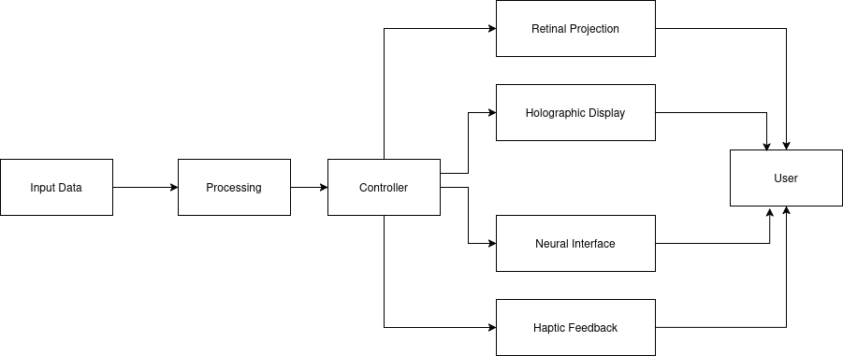
Fig :Block diagram Screenless display

Slide 12
Future Work
Miniaturization of Components
Further reduction in size of retinal projection and holographic units to fit into compact wearables like contact lenses.
Enhanced Resolution and Brightness
Improve image clarity and visibility in various lighting conditions, especially for outdoor or bright environments.
Integration with AI and IoT
Enable smart, context-aware visualizations based on user behavior, environment, or real-time data.
Cost Reduction and Mass Production
Make screenless display technologies affordable and scalable for widespread commercial use.
Improved User Safety and Comfort
Ensure eye-safe projection methods and ergonomic designs for prolonged usage.

Slide 13
References
[1] Z. Liu et al., "Holographic Video Communications," IEEE Wireless Communications, vol. 32, no. 2, Feb. 2025.
[2] T. Wang, C. Yang, J. Chen, Y. Zhao, J. Zong, et al., "Naked-eye light field display technology based on mini/micro LED panels: a systematic review and meta-analysis," Scientific Reports, vol. 14, Art. 24381, Oct. 2024.
[3] M. Rutz et al., "Perceived brightness and resolution in retinal scan glasses," arXiv:2403.xxxxx, Jul. 2024.
[4] Y. Jin et al., "Volumetric 3D video: capture, compression, display," arXiv:2404.xxxxx, Apr. 2024.
[5] PointerVol Team, "PointerVol: laser-pointer interaction in volumetric displays," ACM SIGGRAPH, 2024.
[6] K. Akşit and Y. Itoh, "HoloBeam: paper-thin near-eye displays," arXiv:2212.xxxxx, Dec. 2022.
[7] P. Chakravarthula et al., "Gaze-contingent retinal speckle suppression for foveated holographic displays," arXiv:2111.xxxxx, Nov. 2021.
[8] M. J. Jeong et al., "Screenless Display for Interactive Applications," Applied Sciences, vol. 11, no. 1, p. 117, Jan. 2021.
[9] W. Song et al., "Large-scale Huygens metasurfaces for holographic near-eye displays," arXiv:2010.xxxxx, Oct. 2020.
[10] P. S. Bhosale, R. Kale, and P. P. Salve, "Screenless Display: A Review," IJSRCSEIT, vol. 8, no. 1, pp. 337-343, 2022.
[11] V. Kumar, "Screenless Display Technology," SlideShare, 2024.
[12] M. Mierse, “Build a Sci-Fi aerial display,” IEEE Spectrum, Oct. 20, 2024. [Online]. Available: https://spectrum.ieee.org/diy-scifi-aerial-display.

Slide 14
[13] Virtual retinal display, Wikipedia, The Free Encyclopedia, 2025. [Online]. (Accessed: Jun. 12, 2025).
[14] M. J. Jeong et al., “Screenless display for interactive applications,” Appl. Sci., vol. 11, no. 1, p. 117, 2021.
[15] H. Fuchs et al., “A survey of techniques for 3D display,” Comput. Graph. Forum, vol. 25, no. 4, pp. 1105–1126, 2006.
[16] X. Yang et al., “Progress in volumetric 3D display technologies,” IEEE Access, vol. 8, pp. 98661–98673, 2020.
[17] J. S. Kim et al., “Review of holographic 3D display technologies,” J. Korean Phys. Soc., vol. 63, no. 1, pp. 11–20, 2013.
[18] M. Lucente et al., “A survey of light-field displays,” Proc. IEEE, vol. 101, no. 7, pp. 1469–1487, 2013.
[19] H. Kuwahara et al., “Three-dimensional displays: Technologies and applications,” Proc. IEEE, vol. 101, no. 7, pp. 1508–1523, 2013.
[20] H. Saito et al., “Laser-plasma scanning 3D display for putting digital contents in free space,” Proc. SPIE, vol. 6803, Feb. 2008, doi:10.1117/12.768068.
[21] K. Unagar, “Screenless display (1),” SlideShare, 2024. [Online]. Available: https://www.slideshare.net/slideshow/screenless-display-204907143/204907143.
[22] K. Kumagai and Y. Hayasaki, “Colored voxels of laser-excited aerial volumetric display,” in Digital Holography and 3-D Imaging 2022, D. Chu et al., Eds., OSA Technical Digest (online), paper W3A.1, 2022, doi:10.1364/DH.2022.W3A.1.
[23] K. Kumagai, S. Miura, and Y. Hayasaki, “Aerial re-imaging of femtosecond-laser-excited graphics for volumetric display,” in OSA Imaging and Applied Optics Congress (Imaging, 3D, DH, ISA, COSI), OSA Technical Digest, paper 3Th7E.1, 2021.
[24] W. D. Jones, “Wireless display on a contact lens,” IEEE Spectrum, Nov. 2011.
[25] E. N. Sardinha, M. Munera, N. Zook, D. Western, and V. Ruiz Garate, “Diegetic graphical user interfaces and intuitive control of assistive robots via eye-gaze,” arXiv:2401.03944 [cs.RO], 2024.

